Slide 1
Health AI App
A Hands-On Lab

Slide 2
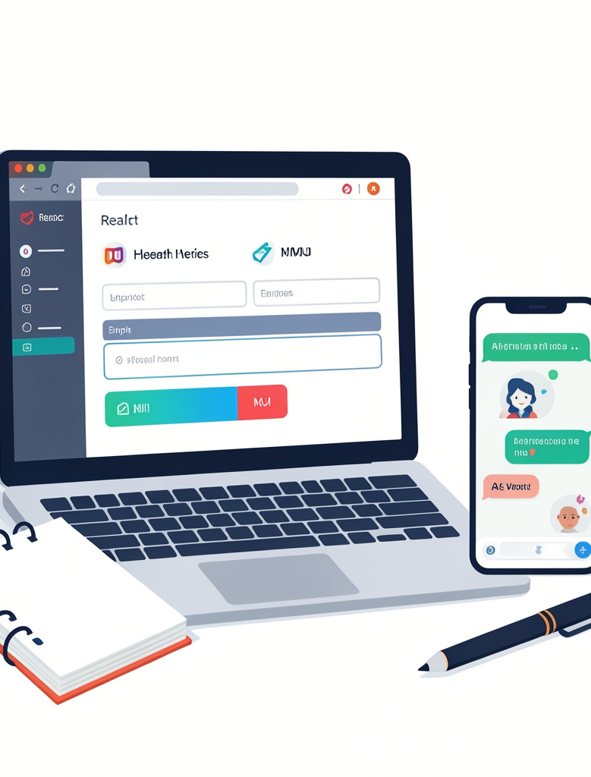
Introduction
Build a simple web app that uses AI to generate a personal health report.
No prior coding required — we’ll use friendly tools (React for UI, MUI for components) and an AI API (OpenRouter) with step-by-step guidance.

Slide 3
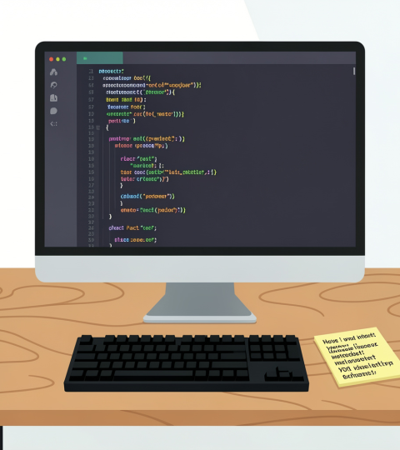
01
Topic 1

Slide 4
Goal & Demo
- See a live demo of the finished app https://dist-jet-psi-81.vercel.app
Goal: collect basic health info, convert units, and get a concise AI report with Body Metrics and Recommendations.

Slide 5
Flow Diagram
User fills form → App sends data to AI (OpenRouter) → AI streams back a health report.
AI system prompt = short job description telling the model how to format the report.

Slide 6
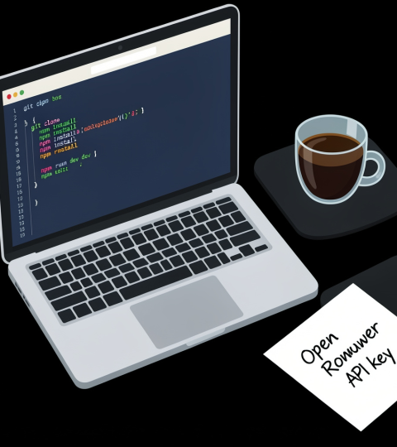
Setup Checklist
VS Code, Node.js (LTS), and Git installed. Get an OpenRouter API key and add it to .env.local.
Run these commands to start:
git clone https://github.com/HKU-IMSE/health-ai-template.git\n\nnpm install\n\nnpm run dev

Slide 7
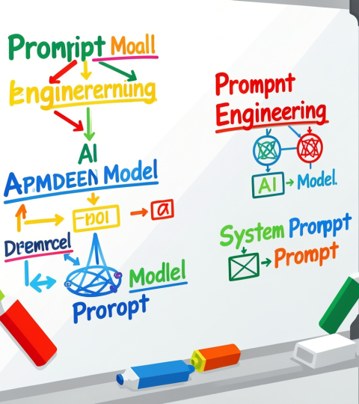
02
Topic 2

Slide 8
Form UI (Part A)
Build a friendly form to collect name, age, sex, unit system, height, weight, activity, conditions, and goals.
Use MUI components (TextField, Select, ToggleButtonGroup, Button). Estimated time: 3–4 hours.

Slide 9
Unit Conversion (Part B)
Convert imperial → metric: (ft + in) × 2.54 = cm and lbs × 0.453592 = kg.
Worked example: 5 ft 9 in / 154 lbs → 175.3 cm / 69.9 kg. Estimated time: 1.5–2 hours.

Slide 10
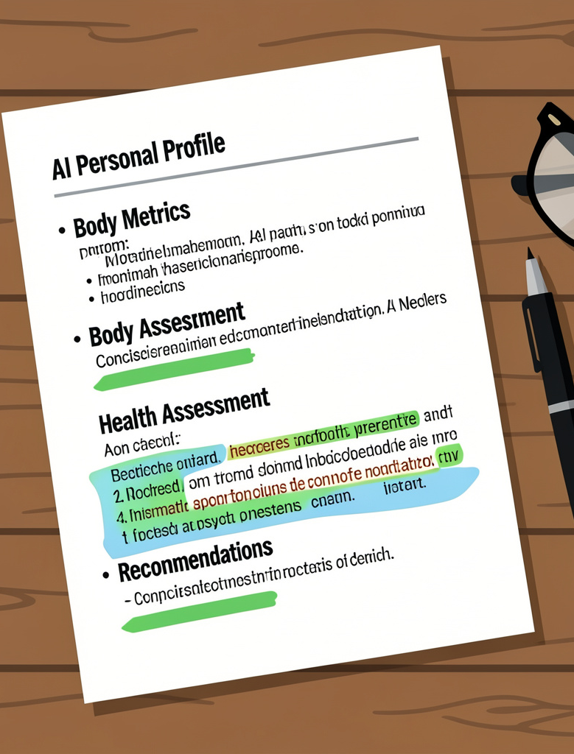
AI Prompt (Part C)
A system prompt is a job description for the AI. It tells the model the exact output format and tone.
Require these 4 sections: Personal Profile, Body Metrics, Health Assessment, Recommendations. Keep each recommendations subsection concise. Estimated time: 2–3 hours.

Slide 11
Bonus Part
Ready for extra challenges? Try adding input validation to improve user experience, a clear/reset button for convenience, or create an extra AI report section like a meal plan. You can also experiment with switching AI models. These tasks help deepen your skills and make the app even more powerful and user-friendly!

Slide 12
Conclusions
You built a form, unit conversion, and an AI-powered report flow — a working health AI web app by the end of the lab.
Resources: React, MUI, OpenRouter, Vercel AI SDK docs.
You just built a real AI-powered app — what will you create next?

Slide 13
Thank you
Do you have any questions?
youremail@freepik.com
+00 000 000 000
yourwebsite.com
Please keep this slide for attribution

